Slide 1
AGENDA
What is Machine learning
How does machine learning works and learn
Types of machine learning
Application of machine learning
Challenges
What is data
Visualization of data
Data preparation
Data tuning

Slide 2
What is AI?
AI is short for artificial intelligence
Refers to the ability of machines to perform tasks that ordinarily require human intelligence, such as understanding natural language and recognizing objects.

Slide 3
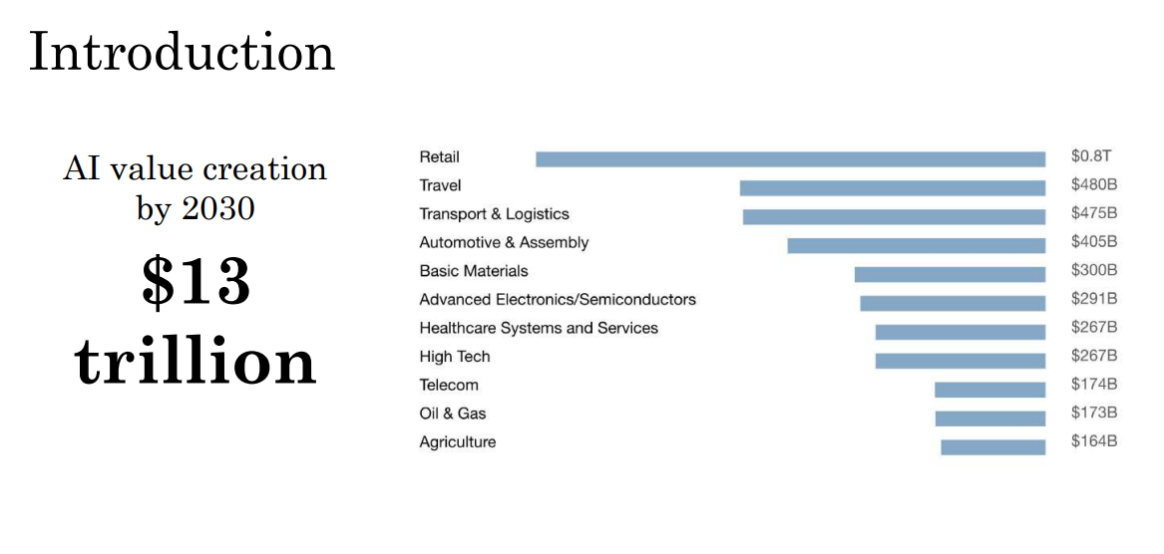

Slide 4
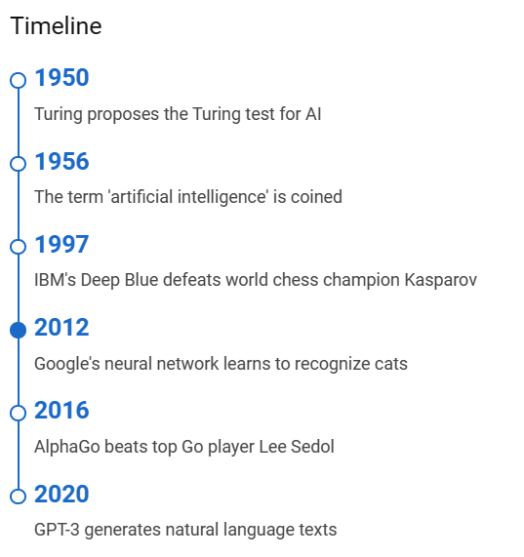
Timeline

Slide 5
AI
Artificial Intelligence is composed of two words Artificial and Intelligence, where Artificial defines "man-made," and intelligence defines "thinking power", hence AI means "a man-made thinking power.“
It is a branch of computer science by which we can create intelligent machines which can behave like a human, think like humans, and able to make decisions.

Slide 6
Why Artificial Intelligence?
Following are some main reasons to learn about AI:
With the help of AI, you can create such software or devices which can solve real-world problems very easily and with accuracy such as health issues, marketing, traffic issues, etc.
With the help of AI, you can create your personal virtual Assistant, such as Cortana, Google Assistant, Siri, etc.
With the help of AI, you can build such Robots which can work in an environment where survival of humans can be at risk.
AI opens a path for other new technologies, new devices, and new Opportunities.

Slide 7
Goals of Artificial Intelligence
Following are the main goals of Artificial Intelligence:
Replicate human intelligence
Solve Knowledge-intensive tasks
An intelligent connection of perception and action
Building a machine which can perform tasks that requires human intelligence such as:
Proving a theorem
Playing chess
Plan some surgical operation
Driving a car in traffic
Creating some system which can exhibit intelligent behavior, learn new things by itself, demonstrate, explain, and can advise to its user.

Slide 8
What Are the Risks of AI?
When it comes to the risks of AI, there are a few key things you should know.
First and foremost, AI has the potential to displace large numbers of workers.
This is because AI is capable of automating tasks that have traditionally been carried out by human beings.

Slide 9
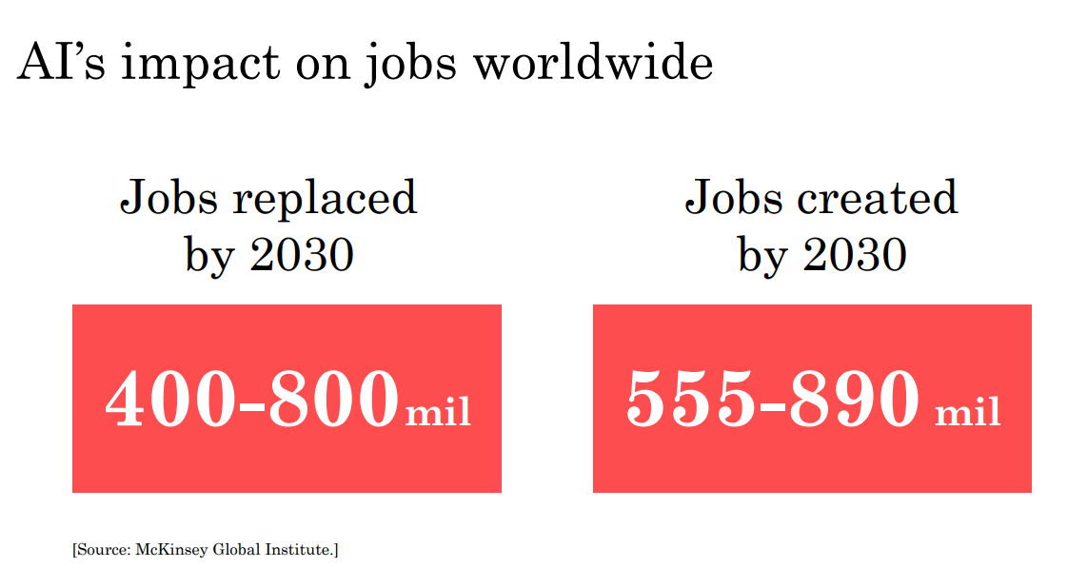

Slide 10
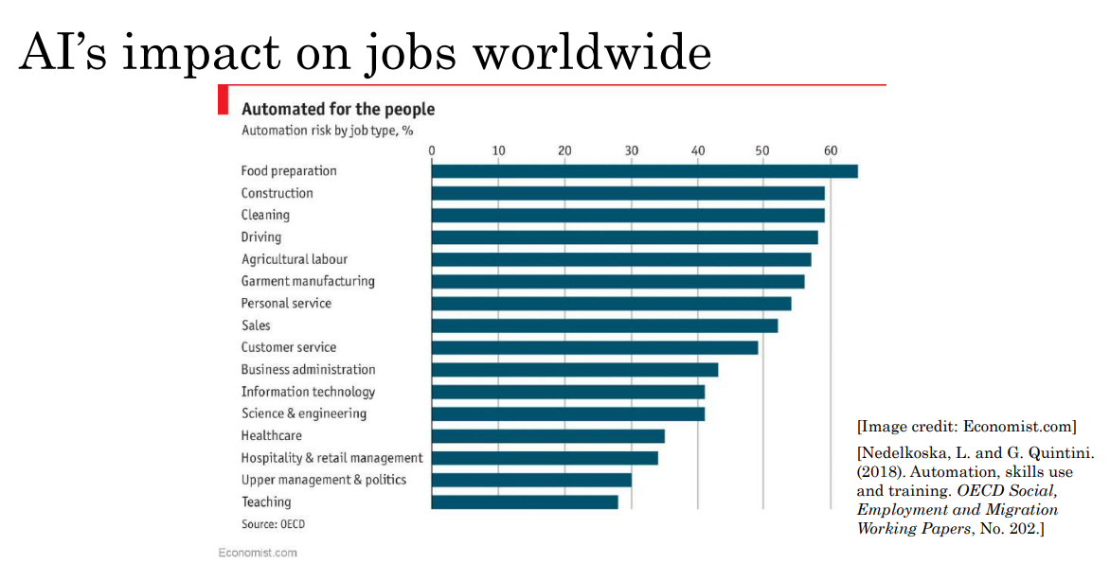

Slide 11
What Are the Risks of AI?
Another big risk posed by AI is the fact that it can be used to perpetuate bias and discrimination.
This is because AI relies on data to learn and make decisions.
And if that data is biased, then the AI will be biased as well.

Slide 12
What Are the Risks of AI?
Finally, there's also the risk that AI could be used to create autonomous weapons, also known as "killer robots."
These are weapons that would be able to select and engage targets without any human involvement. And obviously, this could have disastrous consequences.

Slide 13
What Are the Benefits of AI?
By giving us access to more precise information, AI can assist us in making wiser decisions.
It can help us automate repetitive tasks so that we can focus on more important things.
It can help us make predictions about the future based on past data.

Slide 14
What Are the Benefits of AI?
In general, AI has the potential to make our lives easier and more efficient.
We should be careful not to rely on it too heavily, but used in moderation, it can be a powerful tool.

Slide 15
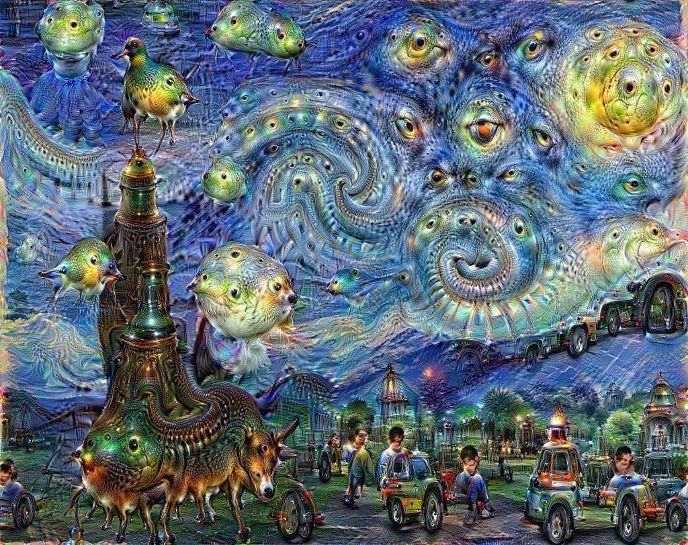


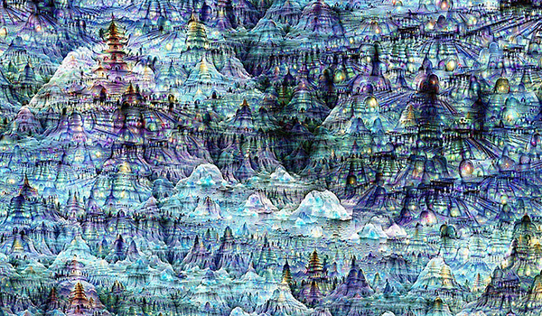
How can AI help in a creative process?
Google Deep Dream

Slide 16
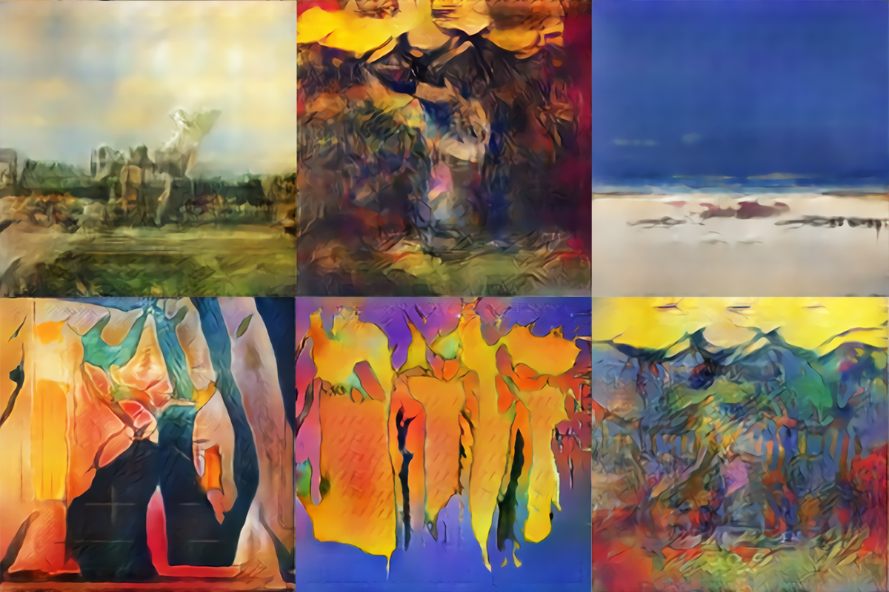
How can AI help in a creative process?

Slide 17

How can AI help in a creative process?

Slide 18
Types of AI-based on technology
Artificial intelligence is categorized based on functionality and technology used.
There are three types of AI-based on technology;
Artificial Super Intelligence (ASI)
Artificial narrow intelligence (ANI)
Artificial general intelligence (AGI)

Slide 19
Artificial narrow intelligence (ANI)
Artificial narrow intelligence (ANI), also referred to as weak AI or narrow AI, is the only type of artificial intelligence we have successfully realized to date.
Narrow AI is goal-oriented, designed to perform singular tasks –
i.e. facial recognition, speech recognition/voice assistants, driving a car, or searching the internet - and is very intelligent at completing the specific task it is programmed to do.

Slide 20
Examples of narrow AI
Rankbrain by Google / Google Search
Siri by Apple, Alexa by Amazon, Cortana by Microsoft and other virtual assistants
IBM’s Watson
Image / facial recognition software
Disease mapping and prediction tools
Manufacturing and drone robots
Email spam filters / social media monitoring tools for dangerous content
Entertainment or marketing content recommendations based on watch/listen/purchase behaviour
Self-driving cars

Slide 21
Artificial general intelligence (AGI)
Artificial general intelligence (AGI), also referred to as strong AI or deep AI, is the concept of a machine with general intelligence that mimics human intelligence and/or behaviors, with the ability to learn and apply its intelligence to solve any problem.
AGI can think, understand, and act in a way that is indistinguishable from that of a human in any given situation.

Slide 22
Artificial Superintelligence (ASI)
Artificial super intelligence (ASI), is the hypothetical AI that doesn’t just mimic or understand human intelligence and behavior
ASI is where machines become self-aware and surpass the capacity of human intelligence and ability.

Slide 23

Machine Learning
Machine Learning, the first step to AI
Machine learning, a branch of artificial intelligence, concerns the construction and study of systems that learn from data.
In 1959, Arthur Samuel defined machine learning as a “Field of study that gives computers the ability to learn without being explicitly programmed”.
Tom M. Mitchell provided a widely quoted, more formal definition: “ A computer program is said to learn from experience E with respect to some class of task T and performance measure P, if its performance at task in T, as measured by P, improves with experience E”.

Slide 24
i) Handwriting recognition learning problem
• Task T: Recognising and classifying handwritten words within images
• Performance P: Percent of words correctly classified
• Training experience E: A dataset of handwritten words with given classifications

Slide 25
ii) A robot driving learning problem
• Task T: Driving on highways using vision sensors
• Performance measure P: Average distance traveled before an error
• training experience: A sequence of images and steering commands recorded while observing a human driver

Slide 26
iii) A chess learning problem
• Task T: Playing chess
• Performance measure P: Percent of games won against opponents
• Training experience E: Playing practice games against itself

Slide 27
Machine learning is a growing technology which enables computers to learn automatically from past data.
Machine Learning is a discipline for artificial intelligence for building computer programs that automatically improve through experience and make predictions.
Applications
Google Search
Voice and Facial Recognition
Online Shopping : Amazon, Flipkart
Uber, Ola

Slide 28
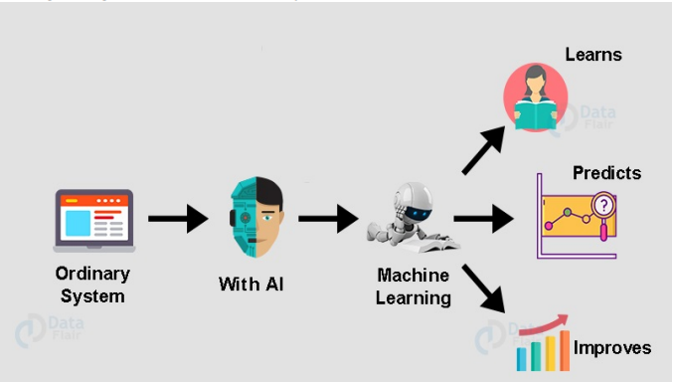
What is Machine Learning
Machine learning is an application of AI that provides systems the ability to learn on their own and improve from experiences without being programmed externally.

Slide 29
AI, ML, DL
Artificial Intelligence: Programs with the ability to mimic human behavior.
Machine Learning: Algorithms with the ability to learn without being explicitly programmed.
Deep Learning: Subset of machine learning in which artificial neural networks adapt and learn from vast amounts of data.
While the term deep learning is vague, it bases on the idea of mimicking the brain by building algorithms that resemble biological neuron’s functionality in the brain.
Artificial Intelligence
Machine Learning
Deep Learning

Slide 30
Example : Online Shopping
Use the past purchasing history, wish lists, cart and past viewing of the user and identify the pattern.
Based on this pattern, it predicts the buying behavior of the user.
So the website create exclusive offers to attract users to buy some additional items.
Example : Search for a book in Amazon, it will show the list of books bought together
This additional books or items recommended is based on purchase history of users.

Slide 31
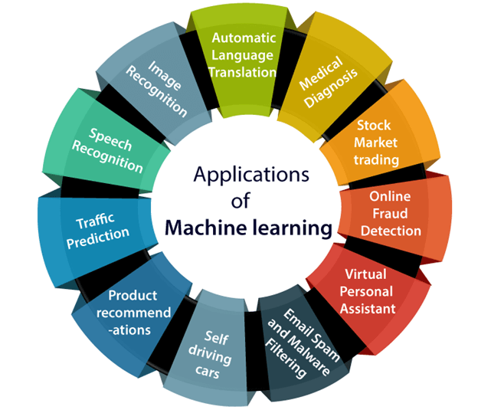

Slide 32
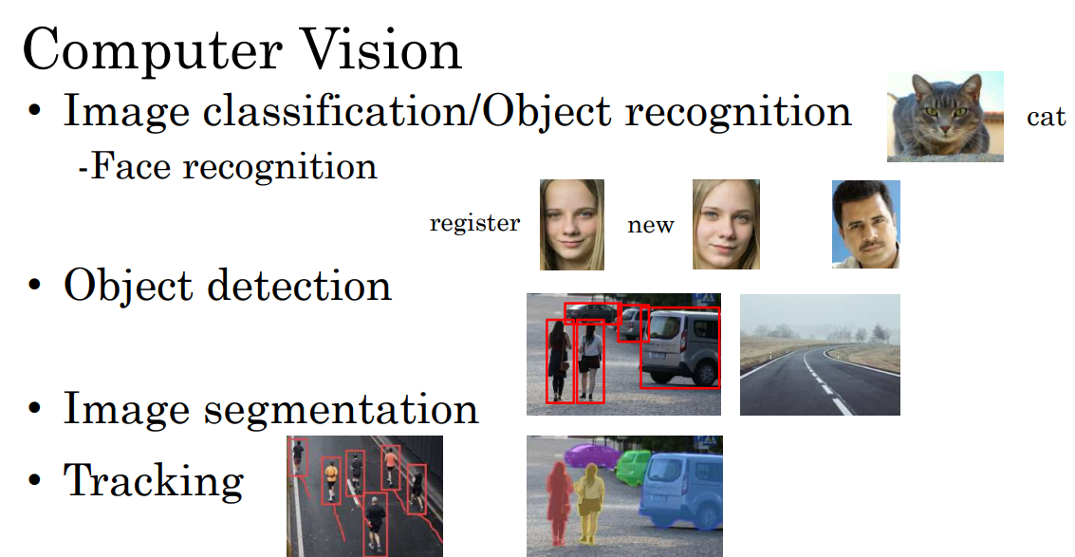

Slide 33
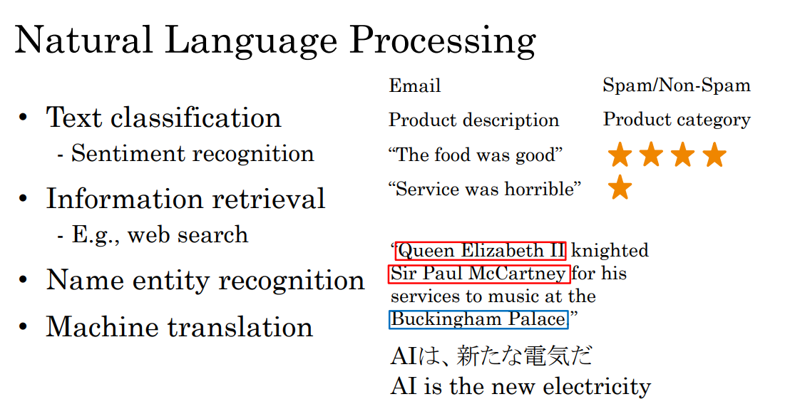

Slide 34
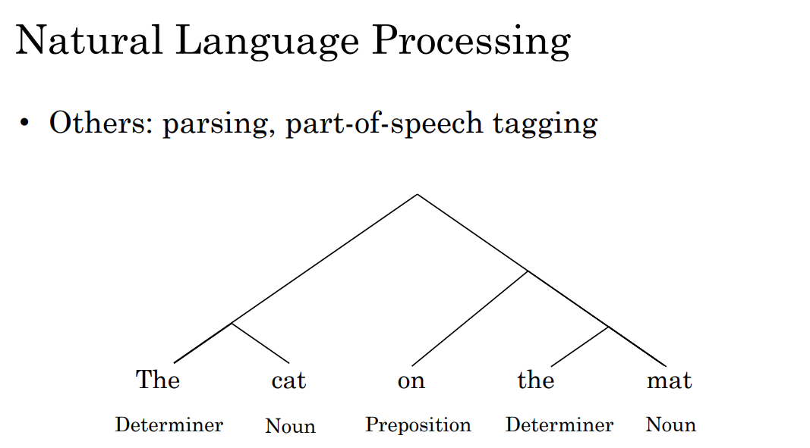

Slide 35
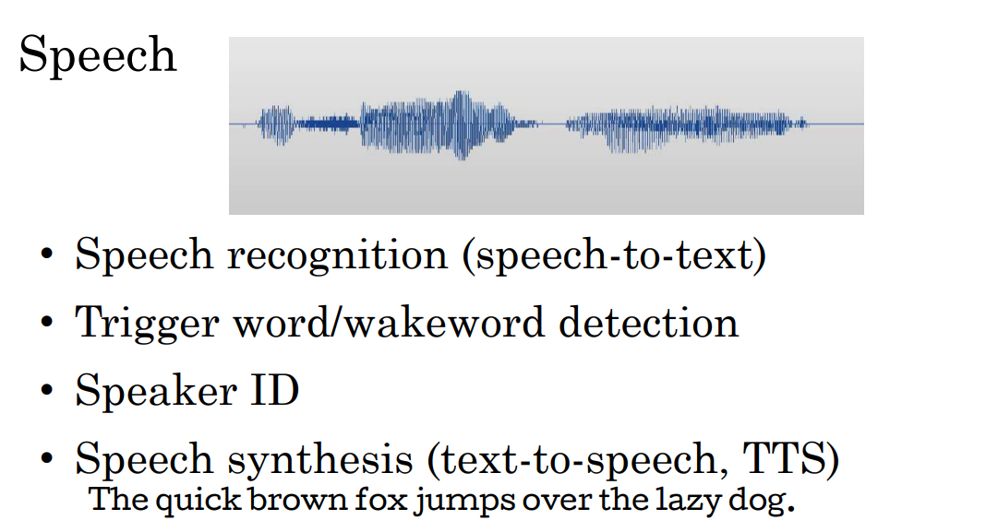

Slide 36
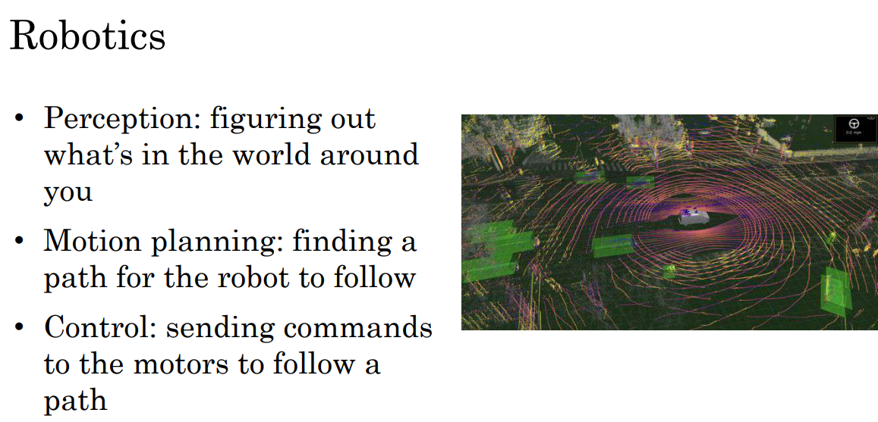

Slide 37
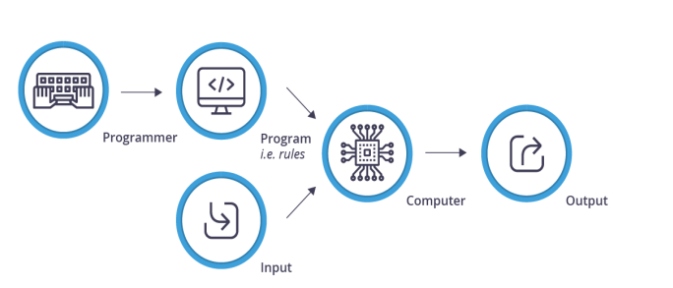
Traditional Computing

Slide 38
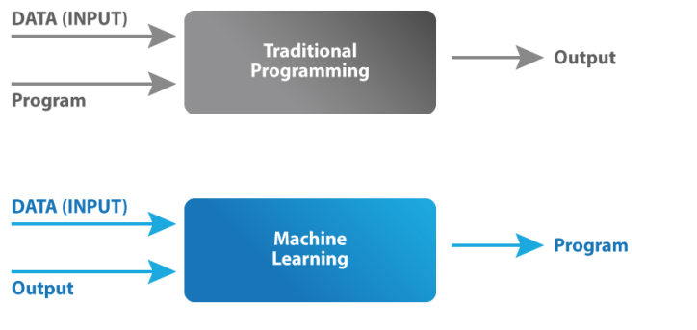
Traditional Computing and Machine Learning

Slide 39
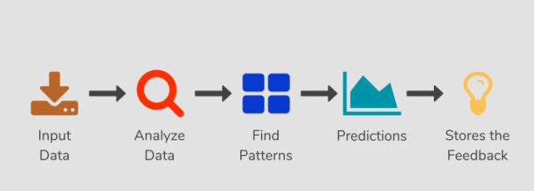
How Machine Learning Works

Slide 40
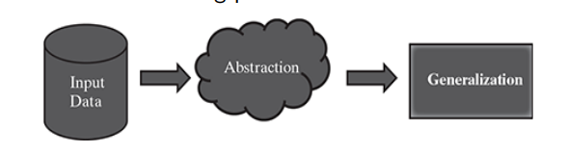
How do Machine learn
The basic machine learning process can be divided into three parts
Data Input: Past data or information is utilized as a basis for future decision-making
Abstraction: The input data is represented in a broader way through the underlying algorithm
Generalization: The abstracted representation is generalized to form a framework for making decisions

Slide 41
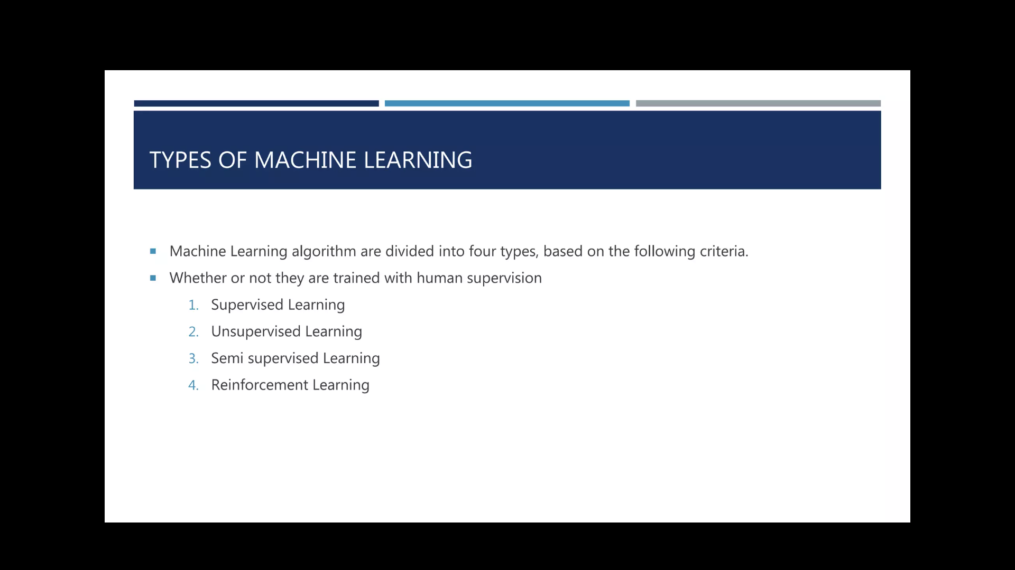

Slide 42
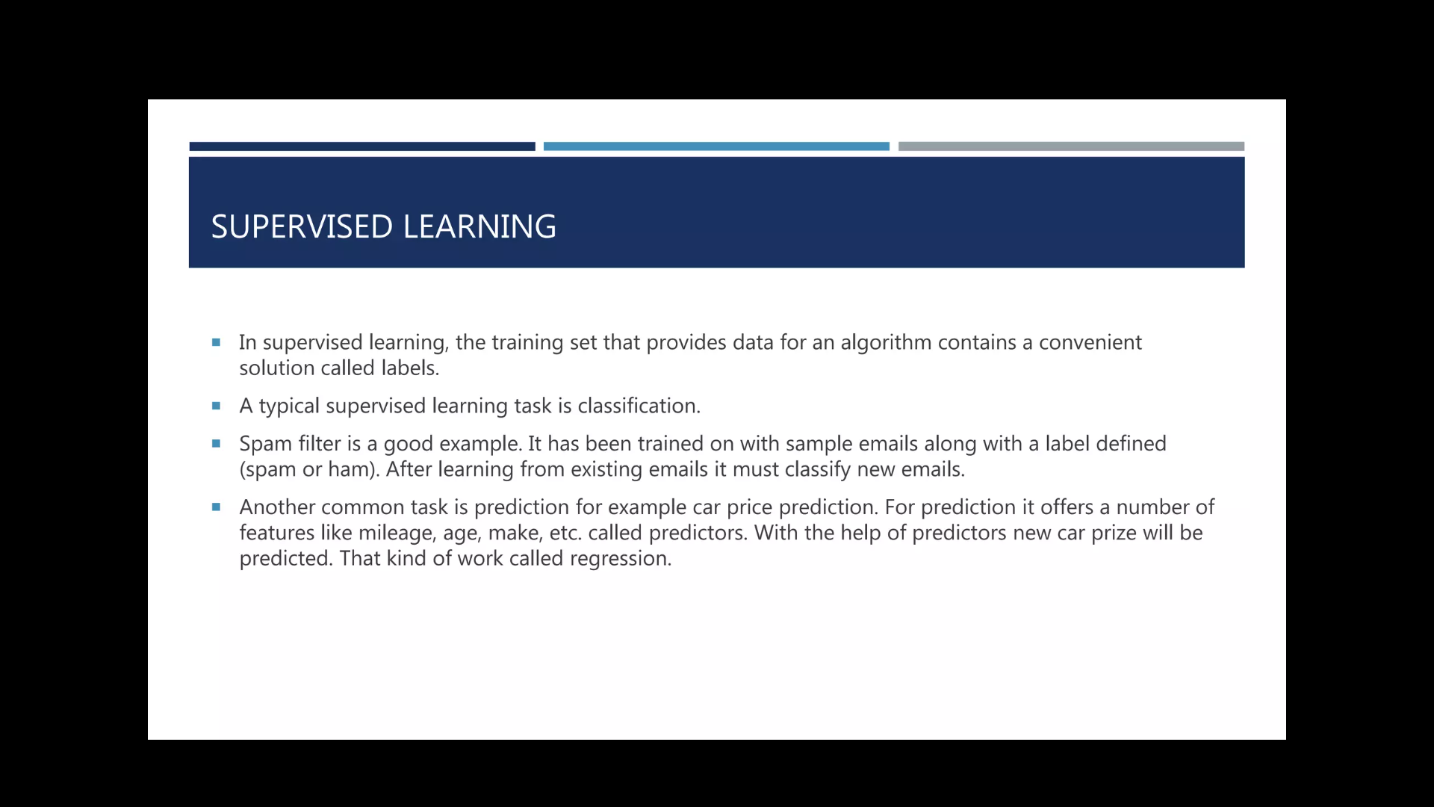

Slide 43
Supervised learning
Supervised learning is the types of machine learning in which machines are trained using well ”labelled” training data, and on basis of that data, Machines predict the output.
The labelled data means some input data is already tagged with the correct output.
In supervised learning, the training data provided to the machines work as the supervisor that teaches the machines to predict the output correctly.
It applies the same concept as a student learns in the supervision of the teacher.

Slide 44
Supervised learning is a process of providing input data as well as correct output data to the machine learning model.
The aim of a supervised learning algorithm is to find a mapping function to map the input variable(x) with the output variable(y).
In the real-world, supervised learning can be used for Risk Assessment, Image classification, Fraud Detection, spam filtering, etc.

Slide 45
Types of supervised Machine learning Algorithms
Classification
Regression
Classification
Classification algorithms are used when the output variable is categorical, which means there are two classes such as Yes-No, Male-Female, True-false, etc.
Random Forest
Decision Trees
Logistic Regression
Support vector Machines

Slide 46
Types of supervised Machine learning Algorithms
Regression
Regression algorithms are used if there is a relationship between the input variable and the output variable.
It is used for the prediction of continuous variables, such as Weather forecasting, Market Trends, etc.
Below are some popular Regression algorithms which come under supervised learning:
Linear Regression
Regression Trees
Non-Linear Regression
Bayesian Linear Regression
Polynomial Regression

Slide 47
Advantages:
With the help of supervised learning, the model can predict the output on the basis of prior experiences.
In supervised learning, we can have an exact idea about the classes of objects.
Supervised learning model helps us to solve various real-world problems such as fraud detection, spam filtering, etc.
Disadvantages
Supervised learning models are not suitable for handling the complex tasks.
Supervised learning cannot predict the correct output if the test data is different from the training dataset.
Training required lots of computation times. In supervised learning, we need enough knowledge about the classes of object.

Slide 48
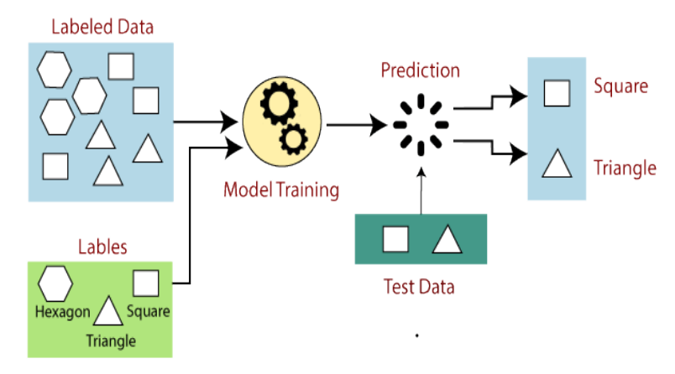
How Supervised Learning Works
In supervised learning, models are trained using labelled dataset, where the model learns about each type of data.
Once the training process is completed, the model is tested on the basis of test data (a subset of the training set), and then it predicts the output.

Slide 49
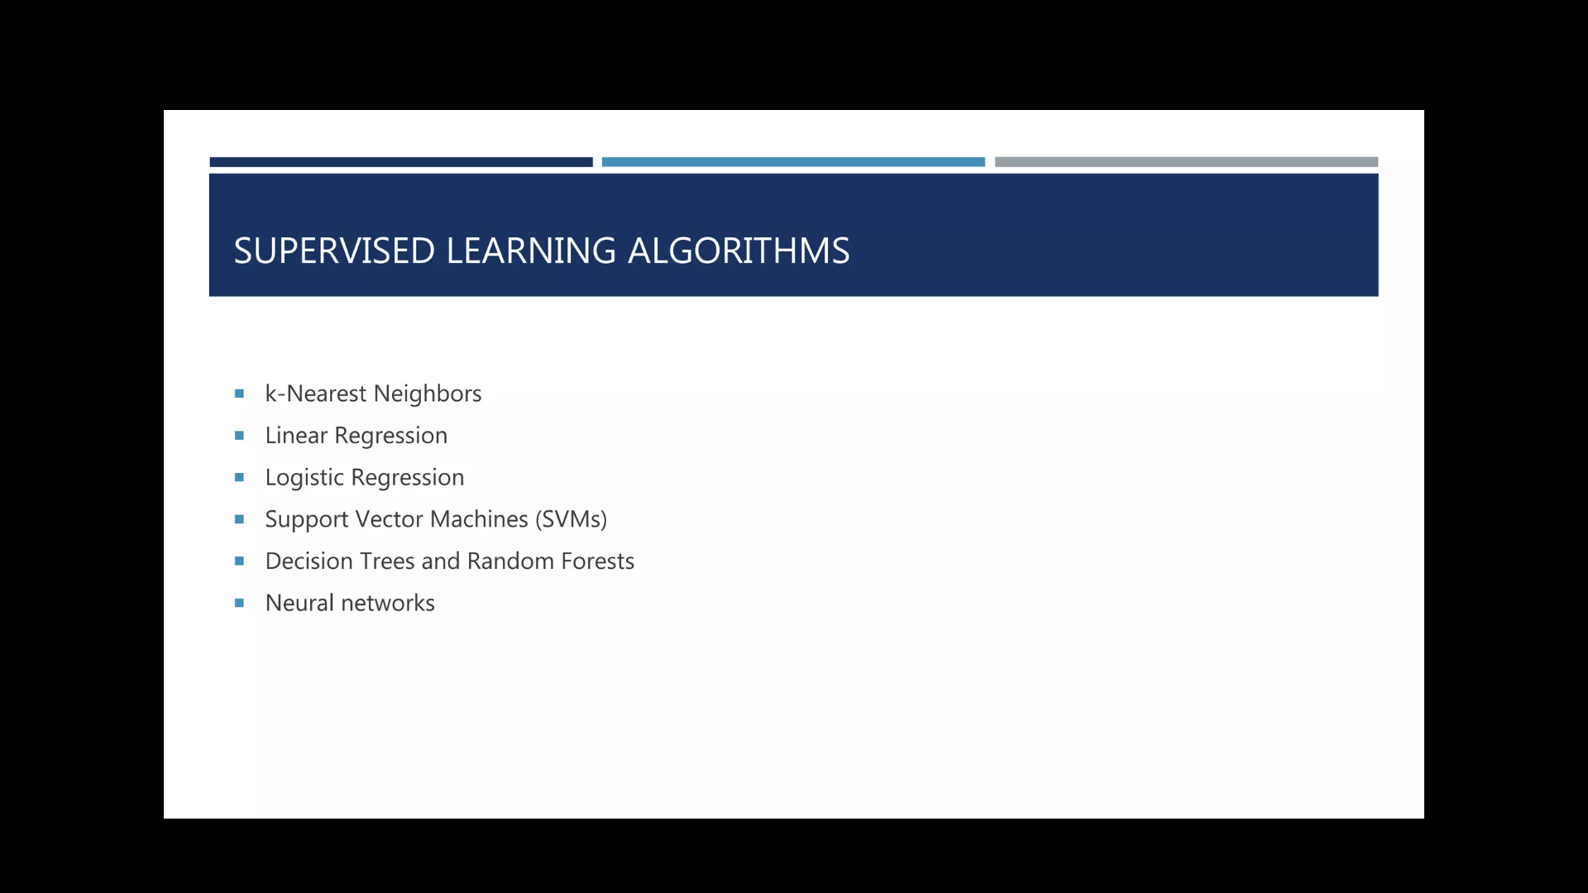

Slide 50
Unsupervised Machine Learning
Unsupervised learning is a type of machine learning in which models are trained using unlabeled dataset and are allowed to act on that data without any supervision
Unsupervised learning cannot be directly applied to a regression or classification problem because unlike supervised learning, we have the input data but no corresponding output data.
The goal of unsupervised learning is to find the underlying structure of dataset, group that data according to similarities, and represent that dataset in a compressed format.

Slide 51
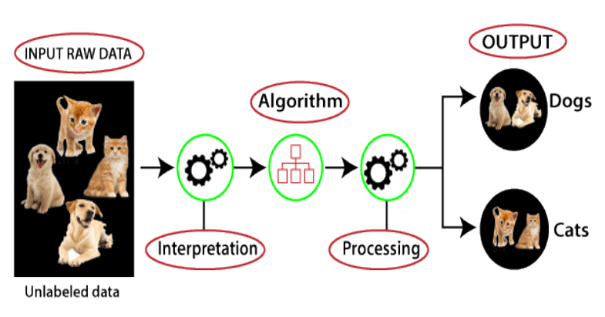
Working of Unsupervised Learning

Slide 52
Here, we have taken an unlabeled input data, which means it is not categorized and corresponding outputs are also not given.
Now, this unlabeled input data is fed to the machine learning model in order to train it.
Firstly, it will interpret the raw data to find the hidden patterns from the data and then will apply suitable algorithms such as k-means clustering, Decision tree, etc.
Once it applies the suitable algorithm, the algorithm divides the data objects into groups according to the similarities and difference between the objects.

Slide 53
Types of Unsupervised Learning Algorithm
Clustering
Association

Slide 54
Clustering: Clustering is a method of grouping the objects into clusters such that objects with most similarities remains into a group and has less or no similarities with the objects of another group.
Cluster analysis finds the commonalities between the data objects and categorizes them as per the presence and absence of those commonalities.
Association: An association rule is an unsupervised learning method which is used for finding the relationships between variables in the large database.
It determines the set of items that occurs together in the dataset.
Association rule makes marketing strategy more effective.
Such as people who buy X item (suppose a bread) are also tend to purchase Y (Butter/Jam) item. A typical example of Association rule is Market Basket Analysis.

Slide 55
Unsupervised Learning algorithms
K-means clustering
• KNN (k-nearest neighbors)
• Hierarchal clustering
• Anomaly detection
• Neural Networks
• Principle Component Analysis
• Independent Component Analysis
• Apriori algorithm
• Singular value decomposition

Slide 56
Unsupervised Learning
Advantages
Unsupervised learning is used for more complex tasks as compared to supervised learning because, in unsupervised learning, we don’t have labeled input data.
Unsupervised learning is preferable as it is easy to get unlabeled data in comparison to labeled data.
Disadvantages
Unsupervised learning is intrinsically more difficult than supervised learning as it does not have corresponding output.
The result of the unsupervised learning algorithm might be less accurate as input data is not labeled, and algorithms do not know the exact output in advance.

Slide 57
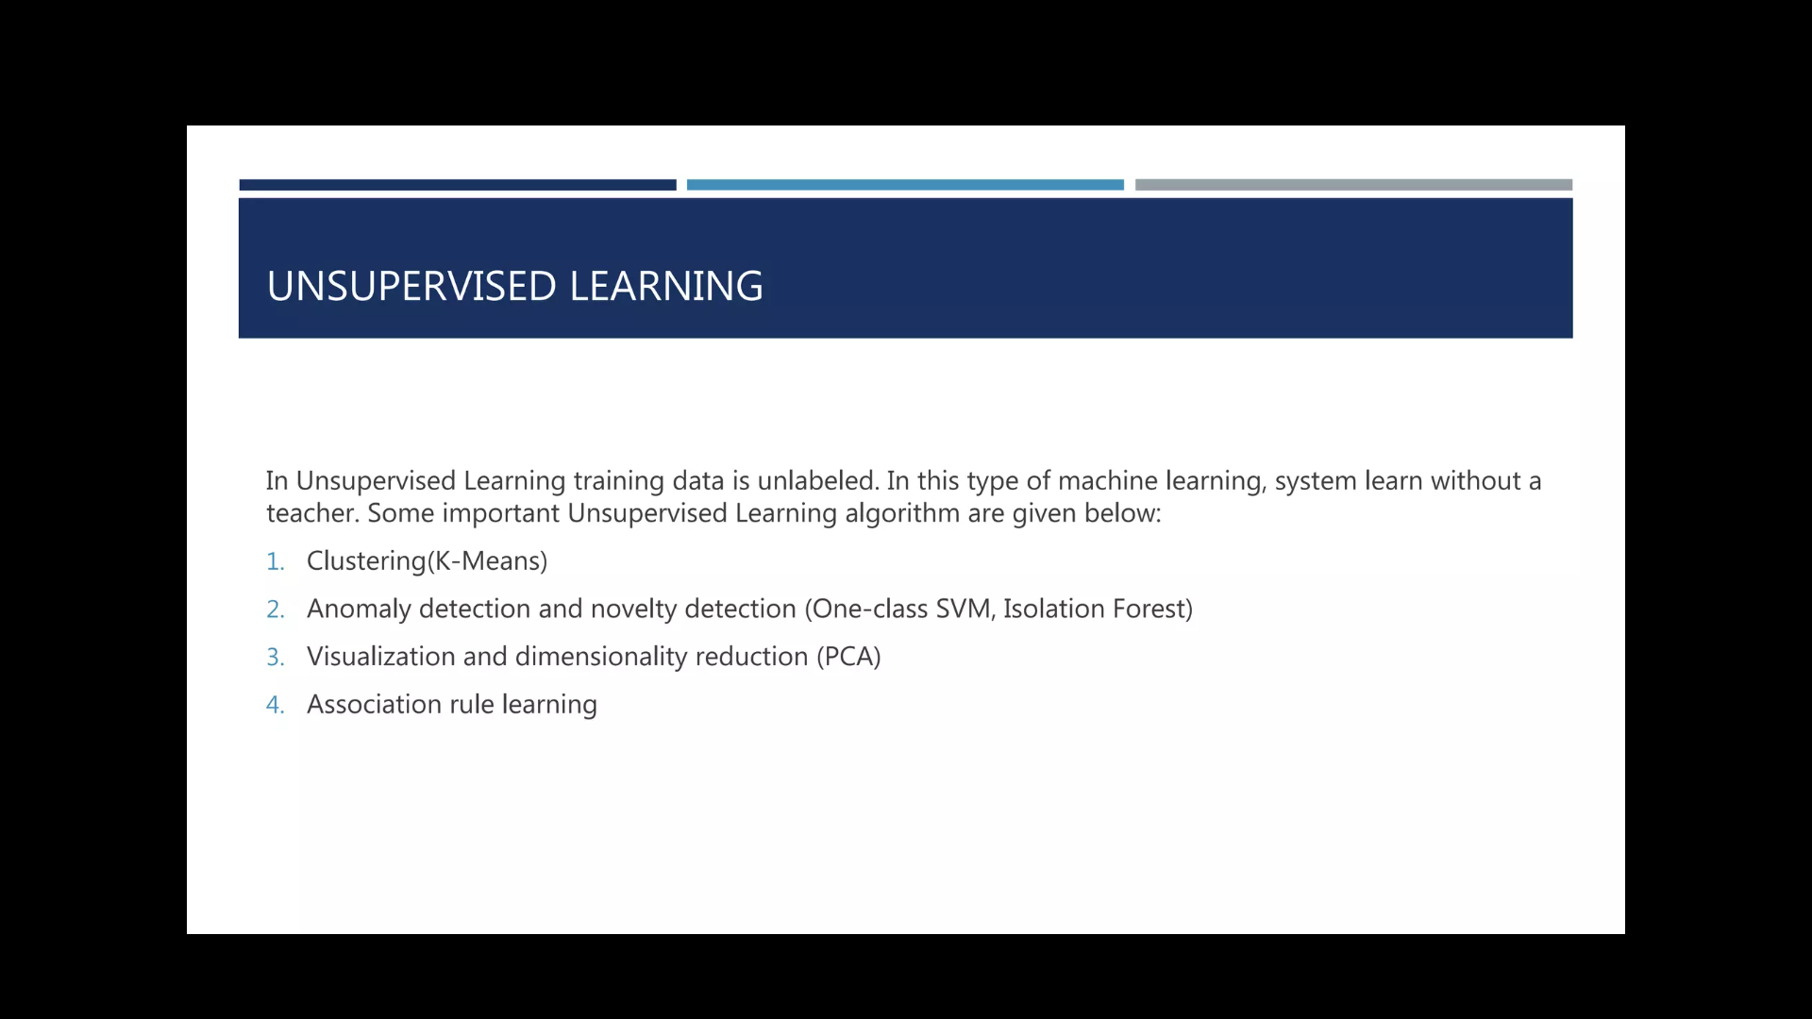

Slide 58
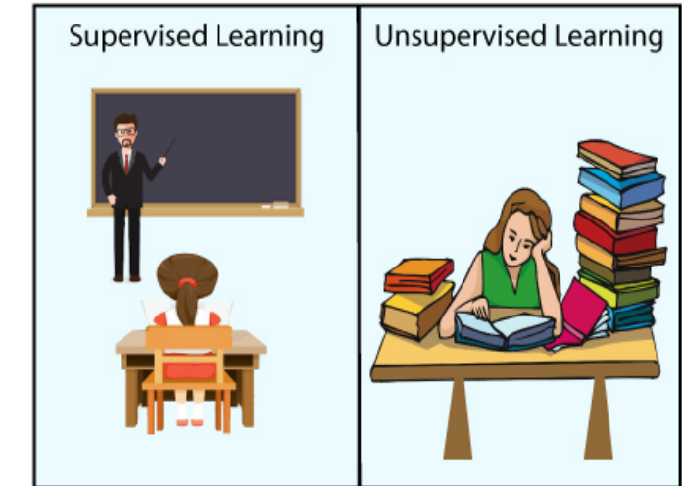
Supervised and Unsupervised Learning

Slide 59
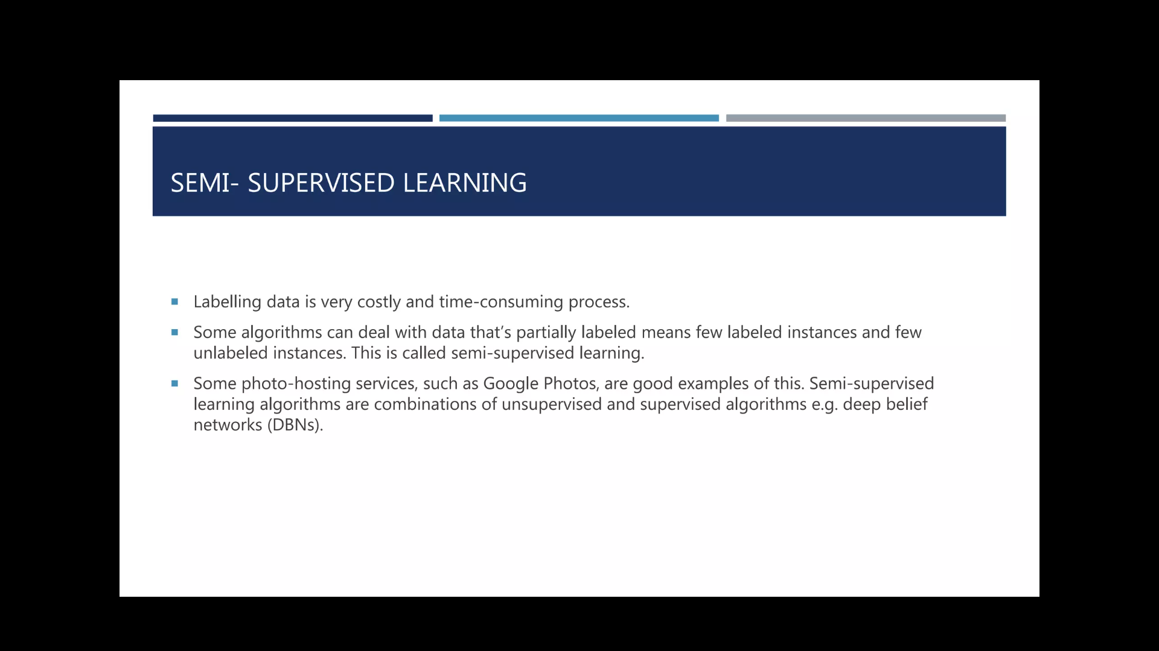

Slide 60
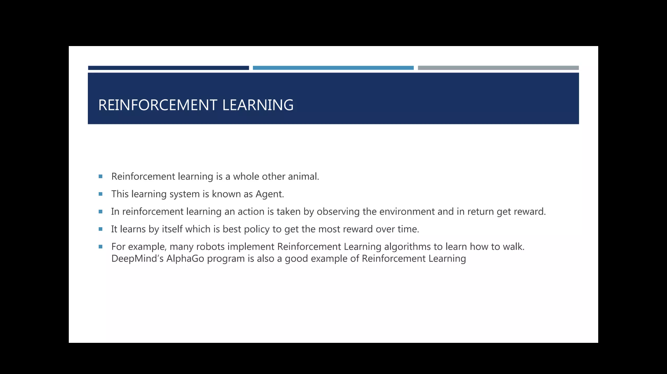

Slide 61
Reinforcement Learning
Reinforcement Learning is a feedback-based Machine learning technique in which an agent learns to behave in an environment by performing the actions and seeing the results of actions.
For each good action, the agent gets positive feedback, and for each bad action, the agent gets negative feedback or penalty.
In Reinforcement Learning, the agent learns automatically using feedbacks without any labeled data, unlike supervised learning.
Since there is no labeled data, so the agent is bound to learn by its experience only. RL solves a specific type of problem where decision making is sequential, and the goal is long-term, such as game-playing, robotics, etc.

Slide 62
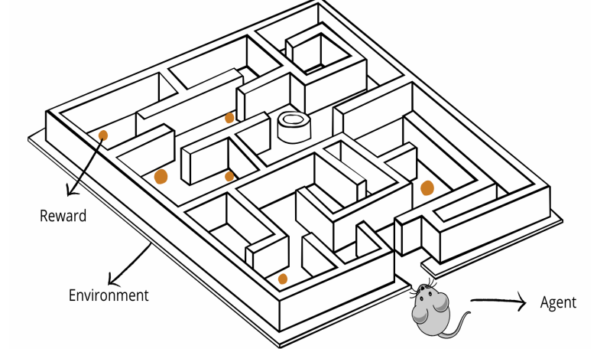
Reinforcement Learning

Slide 63
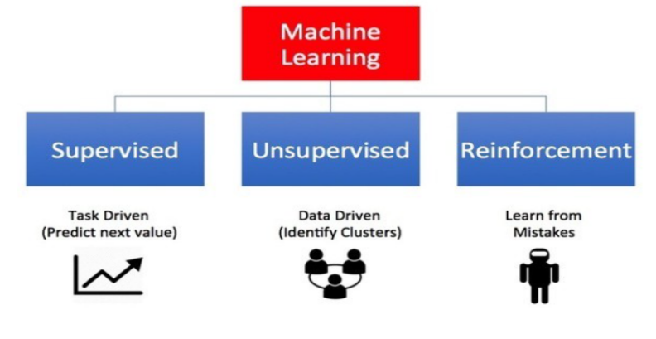
Type of Machine Learning

Slide 64
Type of Machine Learning
Supervised learning – Also called predictive learning. A machine predicts the class of unknown objects based on prior class-related information of similar objects.
Unsupervised learning – Also called descriptive learning. A machine finds patterns in unknown objects by grouping similar objects together.
Reinforcement learning – A machine learns to act on its own to achieve the given goals.

Slide 65
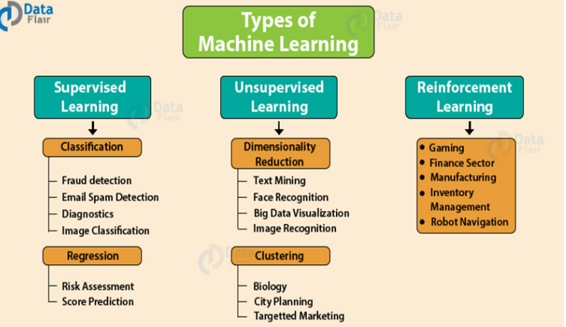

Slide 66
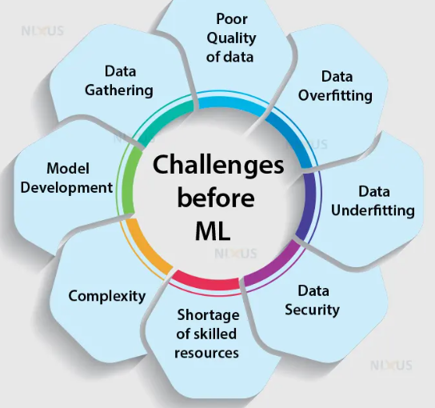
Challenges of Machine Learning

Slide 67
Data Quality and Quantity:
Insufficient Data: ML algorithms often require large amounts of high-quality data for effective training. In some cases, obtaining enough labeled data can be challenging.
Biased Data: If training data is biased, the model can inherit and perpetuate those biases, leading to unfair or discriminatory outcomes.
Overfitting and Under fitting:
Overfitting: Models may perform well on training data but fail to generalize to new, unseen data. Overfitting occurs when a model learns noise or details in the training data that do not generalize well.
Under fitting: On the other hand, under fitting happens when a model is too simple to capture the underlying patterns in the data.

Slide 68
Model Interpretability
Many machine learning models, especially complex ones like deep neural networks, are often considered "black boxes" because it can be challenging to understand how they make decisions.
Interpretable models are crucial in applications where decisions have significant consequences, such as healthcare or finance.
Computational Resources
Training and deploying sophisticated ML models, especially deep neural networks, can require substantial computational resources.
This poses challenges for individuals or organizations with limited access to powerful hardware.
Algorithm Selection
Choosing the most appropriate algorithm for a specific task is not always straightforward.
Different algorithms have strengths and weaknesses, and their performance can vary based on the nature of the data.

Slide 69
Security Concerns:
ML models can be vulnerable to adversarial attacks, where intentionally crafted inputs can mislead the model.
Ensuring the robustness and security of ML systems is crucial, particularly in applications like autonomous vehicles or cybersecurity.
Lack of Standardization
ML field lacks standardization in terms of model architectures, evaluation metrics, and datasets.
This can make it difficult to compare results across different studies or implement consistent best practices.

Slide 70
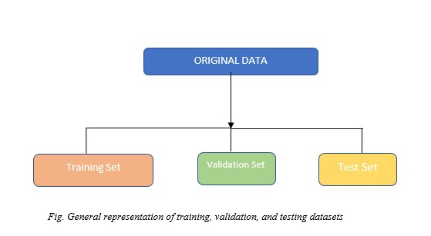
Testing and Validating
Data splitting is one of the simplest preprocessing techniques we can use in a Machine Learning/Deep Learning task.
The original dataset is split into subsets like training, test, and validation sets.

Slide 71
Training Set
The training set is used to fit or train the model. These data points are used to learn the parameters of the model.
This is the biggest of all sets in terms of size.
The training set includes the features and well as labels in the case of supervised learning. In the case of unsupervised learning, it can simply be the feature sets.
The training set is usually taken as 70% of the original dataset.
The model learns patterns and relationships from this data

Slide 72
Validation Set
In addition to training and test data, a separate dataset called validation data
This is used during the training process to tune hyper parameters and prevent overfitting.
Optimal values of hyper parameters are tested against the model trained using the training set.
In Machine Learning or Deep Learning, we generally need to test multiple models with different hyper parameters and check which model gives the best result. This process is carried out with the help of a validation set.
The validation set can be taken as 20% of the original dataset.

Slide 73
Validation techniques
Holdout Validation
K-Fold Cross-Validation
Stratified K-Fold Cross-Validation.
Leave-One-Out Cross-Validation (LOOCV)
Shuffle-Split Cross-Validation
Nested Cross-Validation
Holdout multiple validation

Slide 74
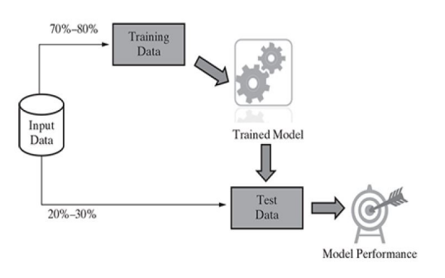
Holdout method

Slide 75
The hold-out method for training a machine learning model is the process of splitting the dataset into wo sets, called the Training set and Test set.
Training set is set aside or held out for training the model. Test set is set aside or held out for testing or evaluating the model.
The split percentage is decided based on the volume of the data available for training purposes.
Generally, 70-30% or 80-20% split is used for splitting the dataset where 70% (80%) of the dataset is used for training and 30% (20%) dataset is used for testing the model.
The following process represents the hold-out method for model selection
Split the dataset in three parts – Training dataset, validation dataset and test dataset.
Train different models using different machine learning algorithms.
For example, train the classification model using logistic regression, random forest,

Slide 76
For the models trained with different algorithms, tune the hyper-parameters and come up with different models.
For each of the algorithms mentioned in step 2, change hyper parameters settings and come with multiple models. 4.
Test the performance of each of these models (belonging to each of the algorithms) on the validation dataset

Slide 77
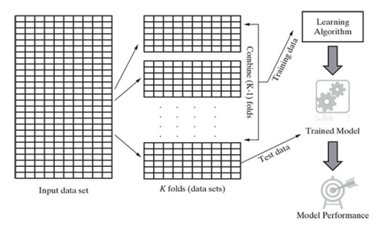
K-fold Cross-validation method

Slide 78
Cross-validation is a resampling procedure used to evaluate machine learning models on a limited data sample.
The procedure has a single parameter called k that refers to the number of groups that a given data sample is to be split into. As such, the procedure is often called k-fold cross-validation.
When a specific value for k is chosen, it may be used in place of k in the reference to the model, such as k=10 becoming 10-Fold cross-validation.
K-fold Cross-validation method : Procedure
Shuffle the dataset randomly.
Split the dataset into k groups
For each unique group:
Take the group as a hold out or test data set
Take the remaining groups as a training data set
Fit a model on the training set and evaluate it on the test set
Retain the evaluation score and discard the model

Slide 79
Stratified K-Fold Cross-Validation
Similar to k-fold cross-validation, but it ensures that each fold maintains the same class distribution as the original dataset.
This is especially useful when dealing with imbalanced datasets.
Leave-One-Out Cross-Validation (LOOCV)
A special case of k-fold cross-validation where k is equal to the number of instances in the dataset.
This means that for each iteration, one instance is used for validation, and the model is trained on the remaining instances.
LOOCV provides a high-variance estimate but is computationally expensive.
Shuffle-Split Cross-Validation:
Randomly shuffle the dataset and then split it into training and validation sets.
This process is repeated multiple times, and the average performance is calculated.
This technique is useful when k-fold cross-validation is impractical due to computational constraints.

Slide 80
Nested Cross-Validation:
Combines an outer loop of cross-validation for model evaluation with an inner loop for hyperparameter tuning.
The inner loop helps select the best hyperparameters, and the outer loop assesses the model's performance.
Holdout with Multiple Validation Sets
Divide the dataset into training, validation, and test sets.
The validation set is further split into multiple subsets, and the model is trained and validated on each subset.
This approach helps mitigate the variability introduced by a single validation set.

Slide 81
Testing Set
Once we have the model trained with the training set and the hyper parameter tuned using the validation set, we need to test whether the model can generalize well on unseen data.
To accomplish this, a test set is used. Here we can check and compare the training and test accuracies.
To ensure that the model is not overfitting or under fitting, test accuracies are highly useful.
While choosing the test set the below points should be kept in mind:
The test should contain the same characteristics as of the train set.
It should be large enough to yield statistically significant results

Slide 82
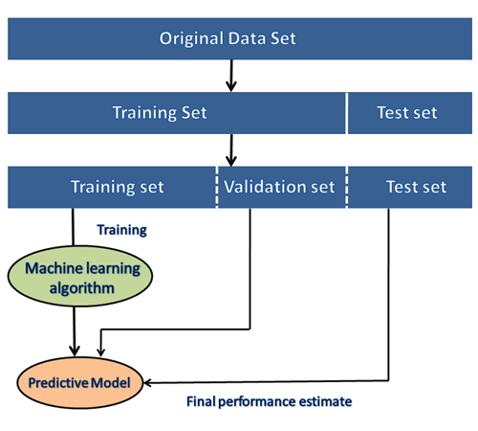

Slide 83
Why do we need a train, validation, and test sets?
The training set is necessary to train the model and learn the parameters.
Almost all Machine learning/Deep Learning tasks should contain at least a training set.
The validation set and test sets are optional but highly recommended to use because only then can a trained model's legibility and accuracy can be verified.
The validation set can be omitted if we do not choose to perform hyper parameter tuning or model selection.

Slide 84
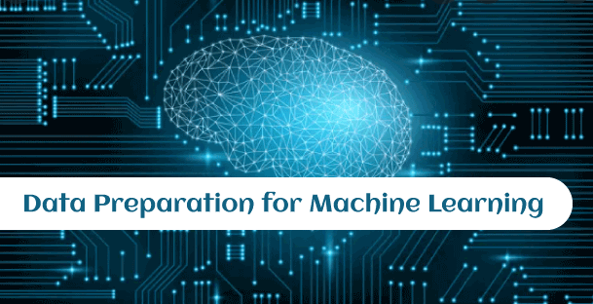

Slide 85
What is Data Preparation?
“Data preparation is defined as a gathering, combining, cleaning, and transforming raw data to make accurate predictions in Machine learning projects”.
Data preparation is also known as data "pre-processing," "data wrangling," "data cleaning," "data pre-processing," and "feature engineering."

Slide 86
Prerequisites for Data Preparation
Data cleaning
Feature Selection
Data Transforms
Feature Engineering
Dimensionality Reduction

Slide 87
Various issues have been reported during the data preparation step in machine learning as follows:
Missing data: Missing data or incomplete records is a prevalent issue found in most datasets.
Outliers or Anomalies: ML algorithms are sensitive to the range and distribution of values when data comes from unknown sources.
Unstructured data format: Data comes from various sources and needs to be extracted into a different format.
Limited Features: Whenever data comes from a single source, it contains limited features, so it is necessary to import data from various sources for feature

Slide 88
Why is Data Preparation important?
It helps identify data issues or errors and significantly reduces the chances of errors.
It increases decision-making capability.
It helps to remove duplicate content to make it worthwhile for different applications.
It increases model performance.

Slide 89
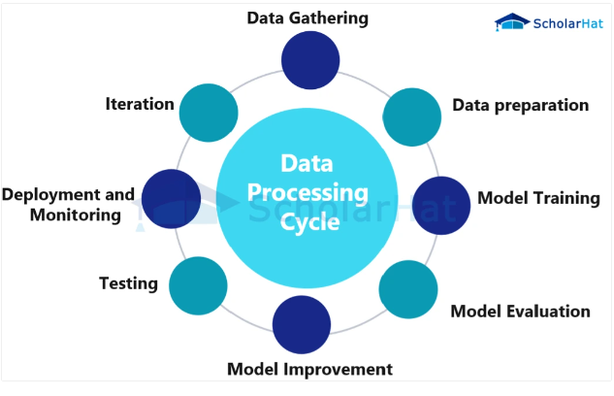

Slide 90
Steps in Data Preparation Process
Understand the problem
Data collection
Profiling and Data Exploration
Data Cleaning and Validation
Data Formatting
Improve data quality
Feature engineering and selection
Splitting data

Slide 91

Visualizing the data

Slide 92
Data visualization
Data visualization helps machine learning analysts to better understand and analyze complex data sets by presenting them in an easily understandable format.
Data visualization is an essential step in data preparation and analysis as it helps to identify outliers, trends, and patterns in the data that may be missed by other forms of analysis.

Slide 93
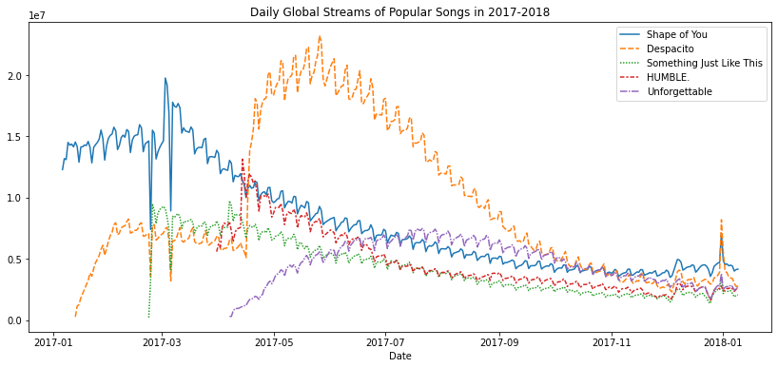
Types of Data Visualization Approaches
Line Charts: In a line chart, each data point is represented by a point on the graph, and these points are connected by a line.

Slide 94
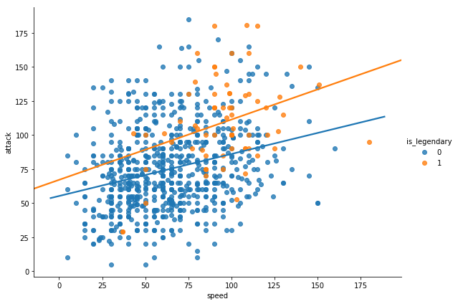
Scatter Plots: A quick and efficient method of displaying the relationship between two variables is to use scatter plots.
With one variable plotted on the x-axis and the other variable drawn on the y-axis, each data point in a scatter plot is represented by a point on the graph.

Slide 95
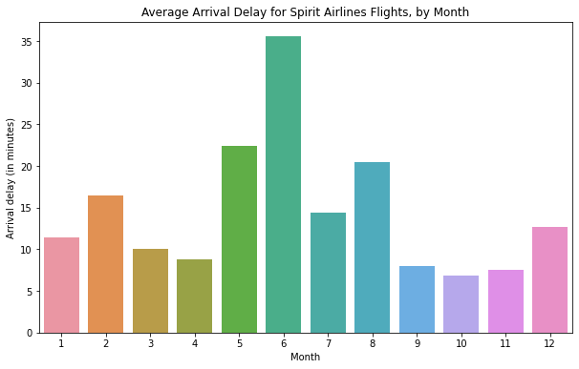
Bar Charts: Bar charts are a common way of displaying categorical data. In a bar chart, each category is represented by a bar, with the height of the bar indicating the frequency or proportion of that category in the data.

Slide 96
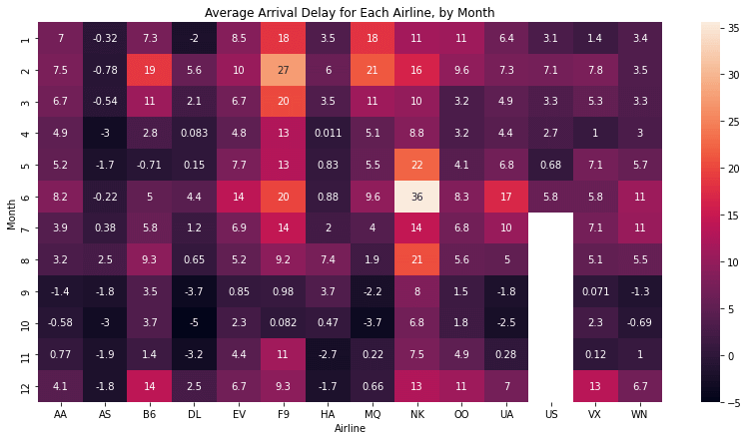
Heat Maps: Heat maps are a type of graphical representation that displays data in a matrix format. The value of the data point that each matrix cell represents determines its hue

Slide 97
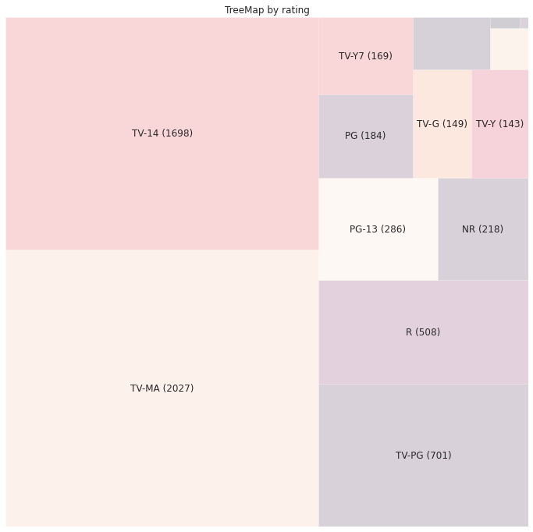
Tree Maps: Tree maps are used to display hierarchical data in a compact format and are useful in showing the relationship between different levels of a hierarchy.

Slide 98
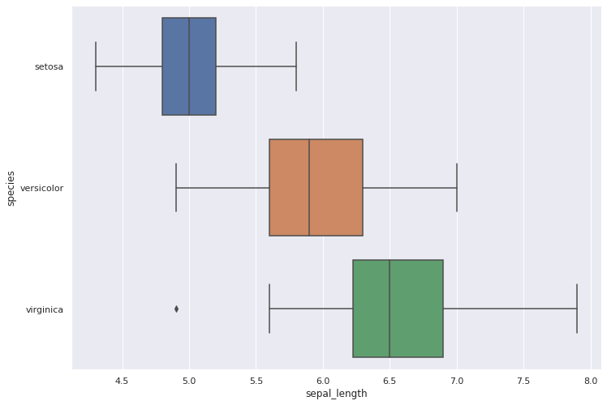
Box Plots: Box plots are a graphical representation of the distribution of a set of data. In a box plot, the median is shown by a line inside the box, while the center box depicts the range of the data.

Slide 99
Uses of Data Visualization in Machine Learning
Identify trends and patterns in data
Communicate insights to stakeholders
Monitor machine learning models
Improve data quality

Slide 100
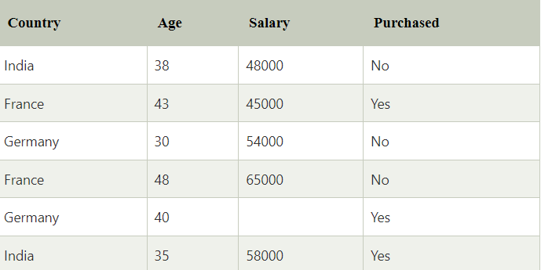
How to get datasets for Machine Learning
What is a dataset?
A dataset is a collection of data in which data is arranged in some order. A dataset can contain any data from a series of an array to a database table
A tabular dataset can be understood as a database table or matrix, where each column corresponds to a particular variable, and each row corresponds to the fields of the dataset.
The most supported file type for a tabular dataset is "Comma Separated File," or CSV.

Slide 101
Types of data in datasets
Numerical data:Such as house price, temperature, etc.
Categorical data:Such as Yes/No, True/False, Blue/green, etc.
Ordinal data:These data are similar to categorical data but can be measured on the basis of comparison.

Slide 102
Types of datasets
Image Datasets
Examples :
ImageNet
CIFAR-10
MNIST
Text Datasets
Examples :
Gutenberg Task dataset
IMDb film reviews dataset
Time Series Datasets:
Examples :
Securities exchange information
Climate information
Sensor readings.
Tabular Datasets

Slide 103
Popular sources for Machine Learning datasets
Kaggle Datasets
UCI Machine Learning Repository
Datasets via AWS
Google's Dataset Search Engine
Microsoft Datasets
Awesome Public Dataset Collection
Government Datasets
Computer Vision Datasets
Scikit-learn dataset

Slide 104
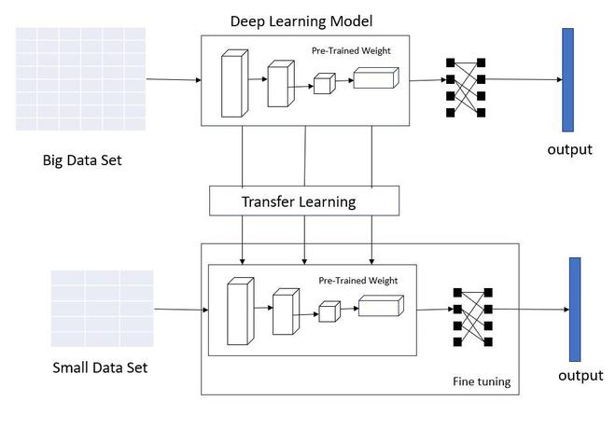
Training and Fine tuning the model

Slide 105
Training and fine tuning of machine learning model
Training steps
Training a machine learning model is a fundamental step in the development of predictive models.
Data Collection
Data Preprocessing
Data Splitting
Model Selection
Model Initialization
Loss Function
Optimization Algorithm
Hyperparameter Tuning

Slide 106
Fine-tuning
Fine-tuning is a subsequent step where a pre-trained model is further optimized for a specific task or dataset.
Select a Pre-trained Model
Dataset Preparation
Model Architecture
Freeze Pre-trained Layers
Hyperparameter Tuning
Key Considerations
Overfitting
Validation Set
Hyper parameter Tuning

Slide 107
Working with real time data
Working with real-time data in a machine learning model involves designing systems and pipelines capable of processing and making predictions on data as it becomes available.
Choose a Real-Time Framework or Architecture
Data Ingestion
Data Preprocessing
Feature Engineering
Model Deployment
Scalability
Security
Data Quality Assurance

Slide 108
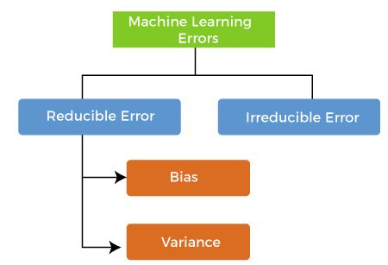
Errors in Machine Learning?
In machine learning, an error is a measure of how accurately an algorithm can make predictions for the previously unknown dataset.
Reducible errors: These errors can be reduced to improve the model accuracy.
Irreducible errors: These errors will always be present in the model

Slide 109
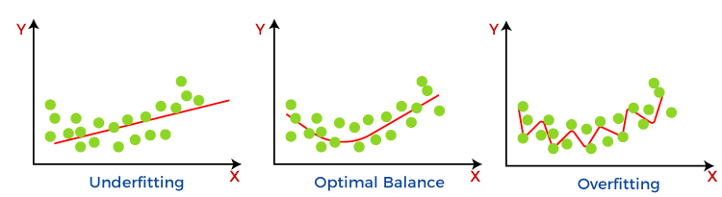

Slide 110
Bias and Variance in Machine Learning
if the machine learning model is not accurate, it can make predictions errors, and these prediction errors are usually known as Bias and Variance.
What is Bias?
While training, the model learns these patterns in the dataset and applies them to test data for prediction.
While making predictions, a difference occurs between prediction values made by the model and actual values/expected values, and this difference is known as bias errors or Errors due to bias.
bias occurs from assumptions in the model, which makes the target function simple to learn.

Slide 111
Low Bias: A low bias model will make fewer assumptions about the form of the target function.
High Bias: A model with a high bias makes more assumptions, and the model becomes unable to capture the important features of our dataset.
Ways to reduce High Bias:
Increase the input features as the model is under fitted.
Decrease the regularization .
Use more complex models, such as including some polynomial features.
Some examples of machine learning algorithms
low bias are Decision Trees, k-Nearest Neighbours and Support Vector Machines.
At the same time, an algorithm with high bias is Linear Regression, Linear Discriminant Analysis and Logistic Regression.

Slide 112
What is a Variance Error?
variance tells that how much a random variable is different from its expected value.
The variance would specify the amount of variation in the prediction if the different training data was used.
Low variance means there is a small variation in the prediction of the target function with changes in the training data set.
High variance shows a large variation in the prediction of the target function with changes in the training dataset.

Slide 113
Ways to Reduce High Variance:
Reduce the input features or number of parameters as a model is overfitted.
Do not use a much complex model.
Increase the training data.
Increase the Regularization.

Slide 114
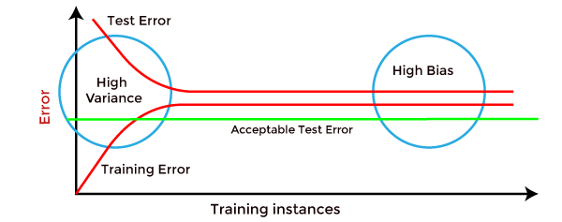
How to identify High variance or High Bias?

Slide 115
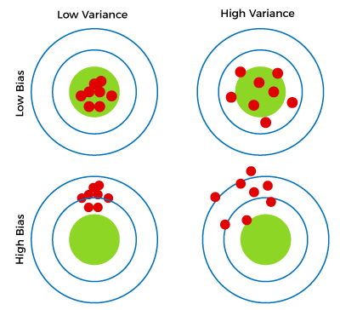
Different Combinations of Bias-Variance

Slide 116
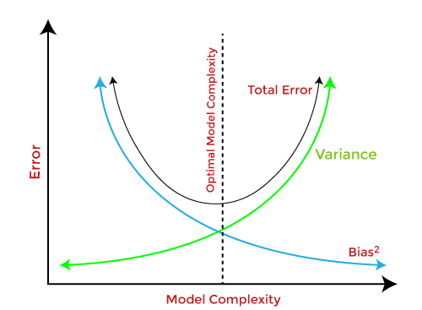
Bias-Variance Trade-Off
If we decrease the variance, it will increase the bias.
If we decrease the bias, it will increase the variance.
So, it is required to make a balance between bias and variance errors, and this balance between the bias error and variance error is known as the Bias-Variance trade-off.
Bias-Variance trade-off is about finding the sweet spot to make a balance between bias and variance errors.

Slide 117


Slide 118


Slide 119


Slide 120


Slide 121


Slide 122


Slide 123


Slide 124


Slide 125


Slide 126


Slide 127


Slide 128


